Slide 1


CSL-401 Project 2
Teaching + Donation @ Mashal Model School

Slide 2
Group Members
Muhammad Hassaan Ghazali (Group Lead)
Hassan Rizwan
Muhammad Bilal
Muhammad Umer
Muhammad Ahmed Mohsin
Muhammad Ali Farooq

Slide 3
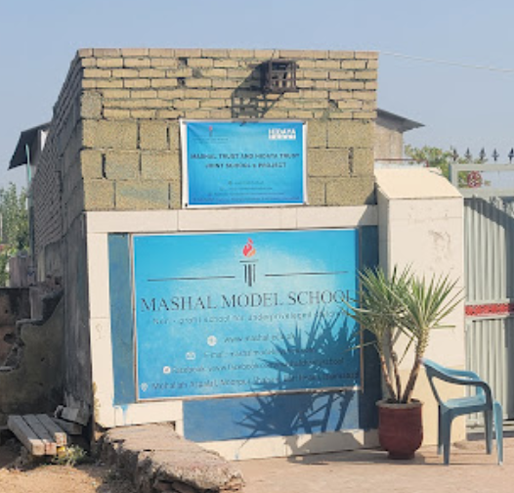
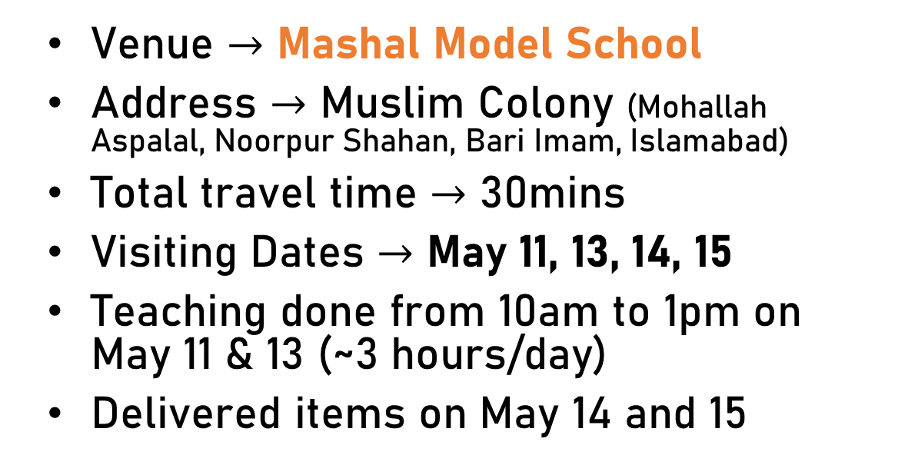
Venue and Date of Visit
Venue $→$ Mashal Model School
Address $→$ Muslim Colony (Mohallah Aspalal, Noorpur Shahan, Bari Imam, Islamabad)
Total travel time $→$ 30mins
Visiting Dates $→$ May 11, 13, 14, 15
Teaching done from 10am to 1pm on May 11 & 13 (~3 hours/day)
Delivered items on May 14 and 15
Fundraised 151K
Purchased Books and Tarpaulin for the school

Slide 4
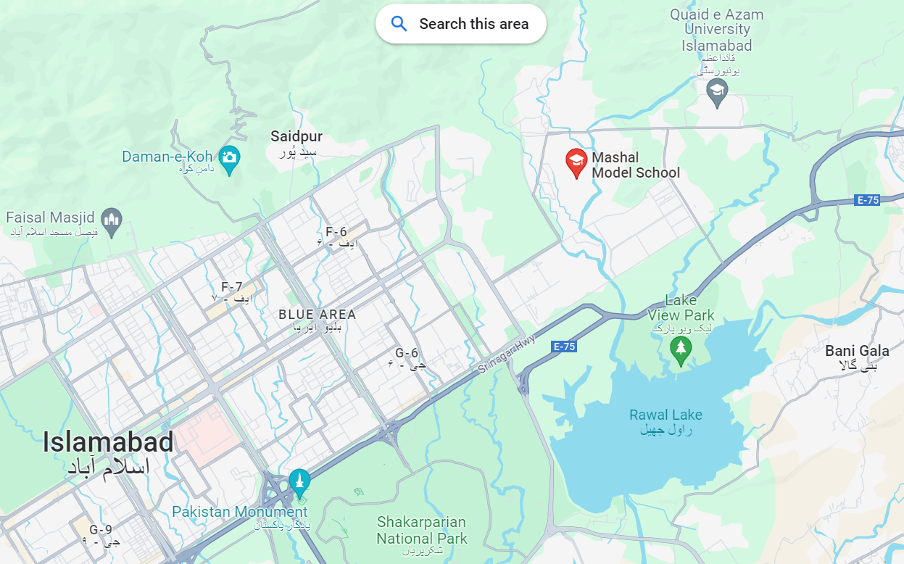
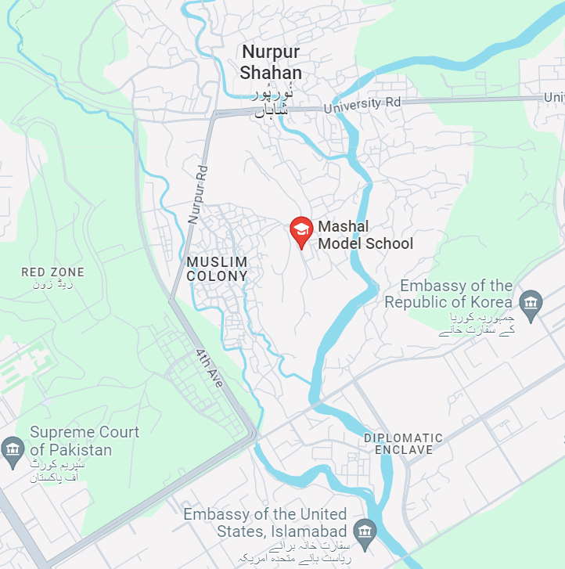

Slide 5
Aims and Objectives of the Project / Relevance / Need of the Project
Objective: Core project aim was to teach students hard sciences and Math for 2 days and donate books and tarpaulin to the school, which they desperately required
Need: Mashal Model School teaches young children that otherwise worked on daily wages as mechanics, or hawkers. The school required funding to purchase books, and due to the extreme heat needed a tarpaulin
The children at the school need motivation and direction to persist on their educational journey and we can serve as role models and mentors
Studying from different teachers gives the students a break from their routine and creates a playful environment which motivates students to partake in class activities and regularly come to school

Slide 6
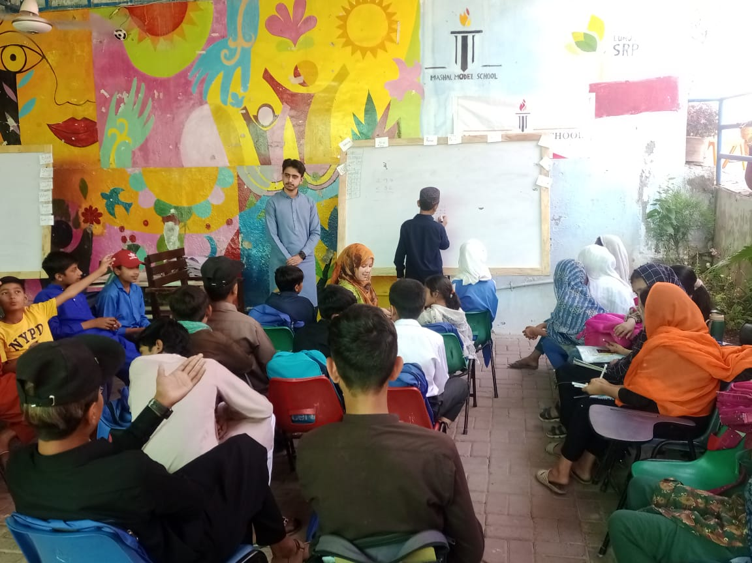
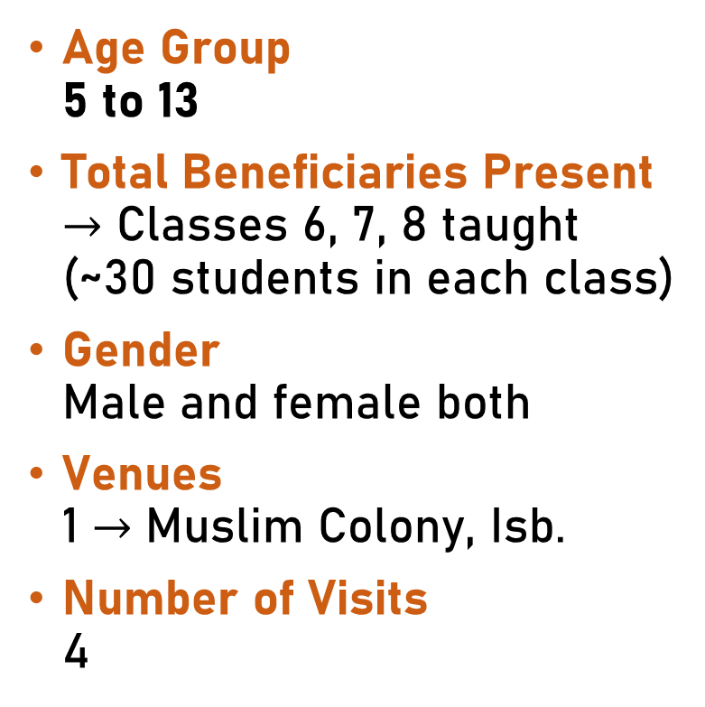
Target Audience
Age Group 5 to 13
Total Beneficiaries Present $→$ Classes 6, 7, 8 taught (~30 students in each class)
Gender Male and female both
Venues 1 $→$ Muslim Colony, Isb.
Number of Visits 4

Slide 7
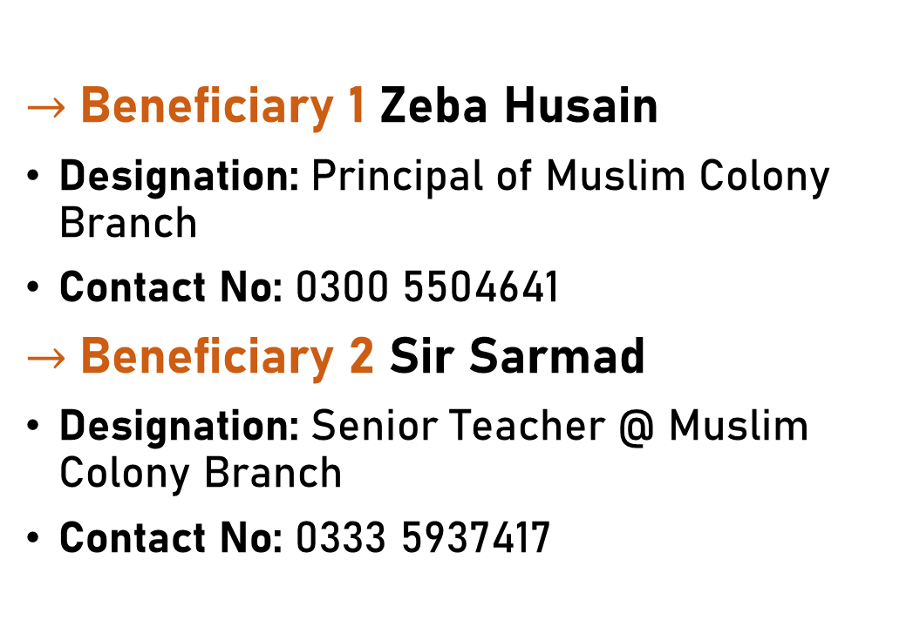
Letter of Acknowledgement
CERTIFICATE NOT RECEIVED YET
WILL BE ADDED BEFORE
PRESENTATION
$→$Beneficiary 1 Zeba Husain
Designation: Principal of Muslim Colony Branch
Contact No: 0300 5504641
$→$Beneficiary 2 Sir Sarmad
Designation: Senior Teacher @ Muslim Colony Branch
Contact No: 0333 5937417

Slide 8
Work Division & Tasks

Slide 9
Pre-execution Meetings & Tasks
Date: May 5, 2024
Place: NUST & Online
Division of group into Subgroups
Muhammad Umer, Hassan Rizwan & Muhammad Ahmed Mohsin to teach students for 2 days and raise 75K in funds
{Muhammad} Hassan Ghazali, Bilal and Ali Farooq to raise 75K funds, acquire all items (books and tarpaulin) and deliver to school and teach students for 1 day
Tasks
Teach students
Collect funds
Acquire and deliver items

Slide 10
Work Division Pre-execution
Name | Task | Hours / person
Muhammad Hassan Ghazali | Taught Students on May 11 Acquired and delivered books & tarpaulin on May 14 & May 15 Fundraised PKR 75K | 5+7+25 = 37 hrs.
Muhammad Ali Farooq
Muhammad Bilal
Muhammad Umer | Taught Students on May 11 & May 13 Fundraised PKR 75K | 5+5+25 = 35 hrs.
Hassan Rizwan
Muhammad Ahmed Mohsin

Slide 11
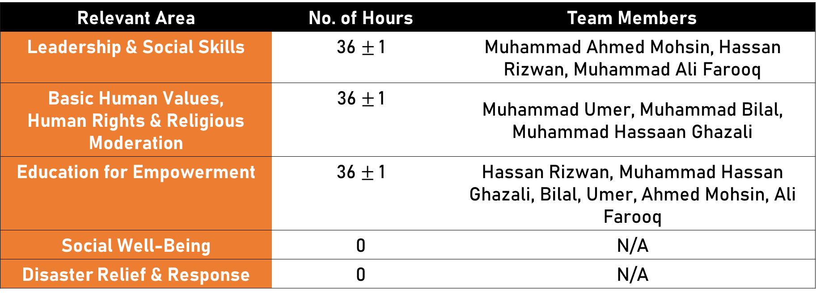
Relevant Areas Covered
Relevant Area | No. of Hours | Team Members
Leadership & Social Skills | 36 $±$1 | Muhammad Ahmed Mohsin, Hassan Rizwan, Muhammad Ali Farooq
Basic Human Values, Human Rights & Religious Moderation | 36$±$1 | Muhammad Umer, Muhammad Bilal, Muhammad Hassaan Ghazali
Education for Empowerment | 36$±$ 1 | Hassan Rizwan, Muhammad Hassan Ghazali, Bilal, Umer, Ahmed Mohsin, Ali Farooq
Social Well-Being | 0 | N/A
Disaster Relief & Response | 0 | N/A

Slide 12
Finance Balance Sheet & Cost Analysis

Slide 13
Total Funds and Spending
 | Amount (group) in PKR | Amount (per person) in PKR
Fundraising | 151,000/- | 25,300/-
Notebooks purchased | 92,000/- | 15,300/-
Textbooks | 27,000/- | 4,500/-
Tarpaulin | 32,000/- | 5,300/-
Books Breakdown
 | Amount (group) in PKR | Amount (per person) in PKR
Textbooks English | 13,000/- | 2,166/-
Notebooks (Eng/Urdu/Math) | 92,000/- | 15,300/-

Slide 14
Proof of Items Purchased (Receipts and Pictures)

Slide 15
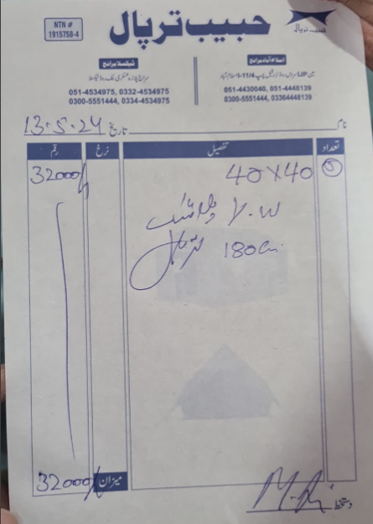
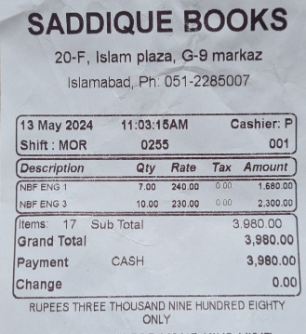
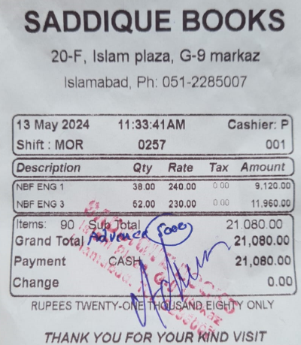
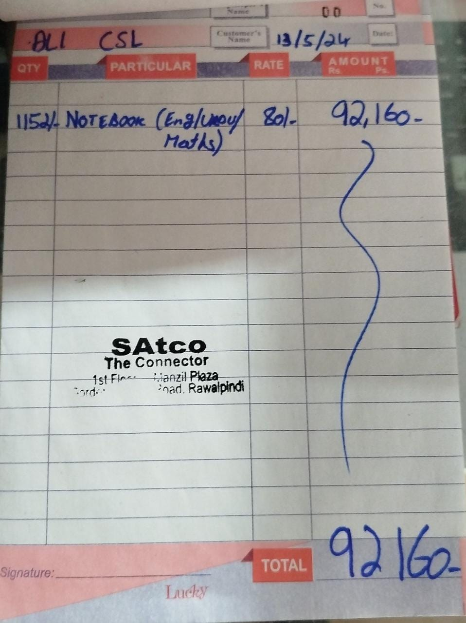
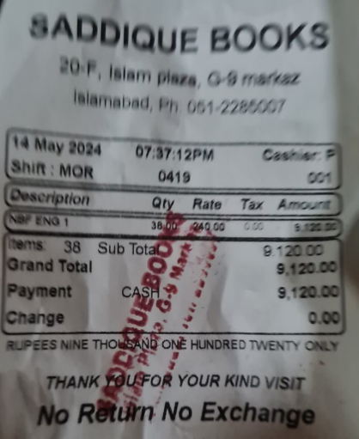

Slide 16
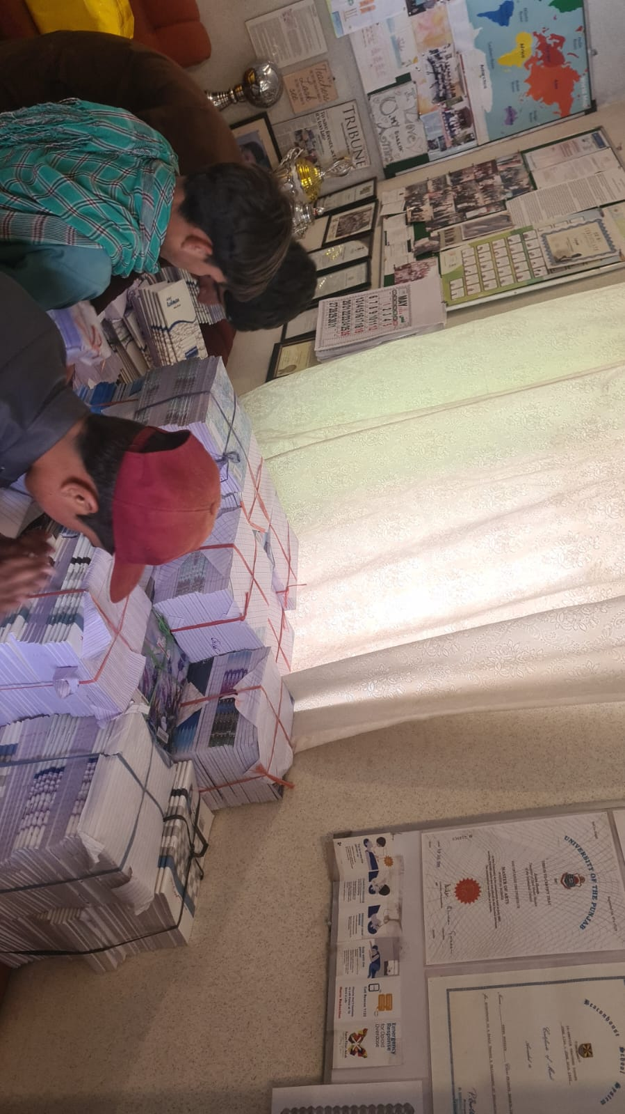
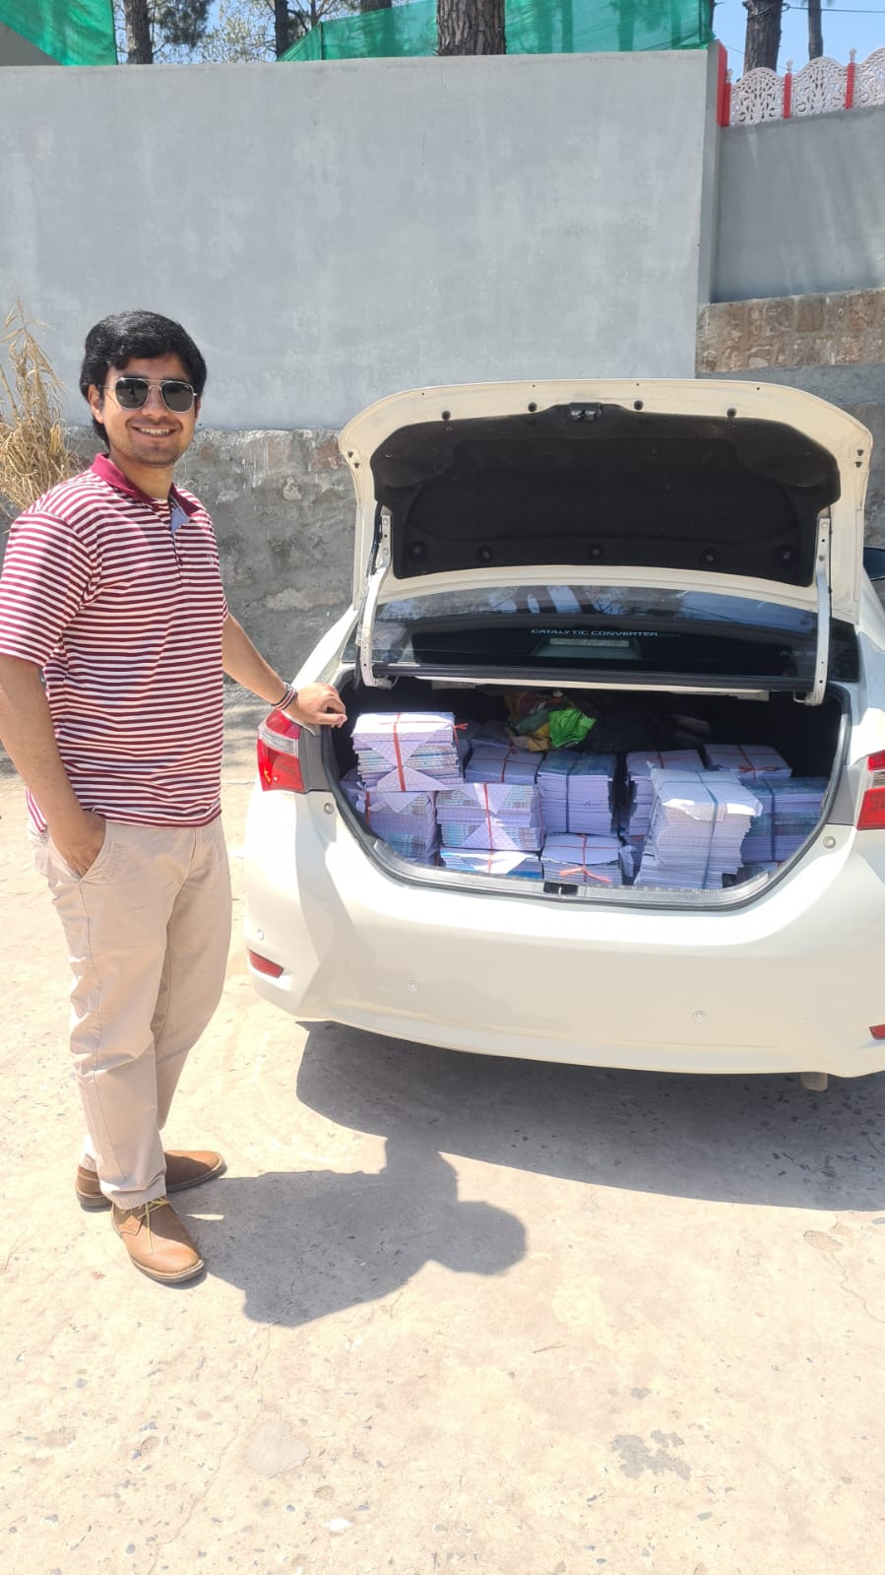
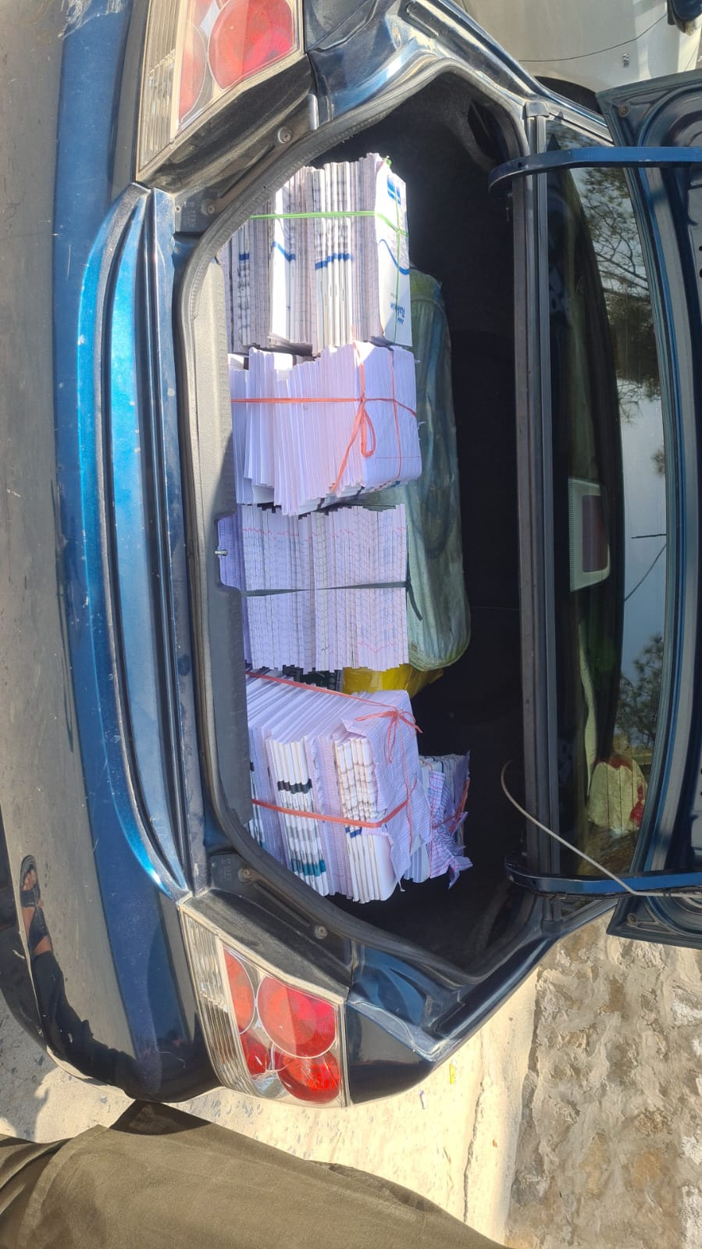

Slide 17
Proof of Presence (Pictures and Video Clips)

Slide 18
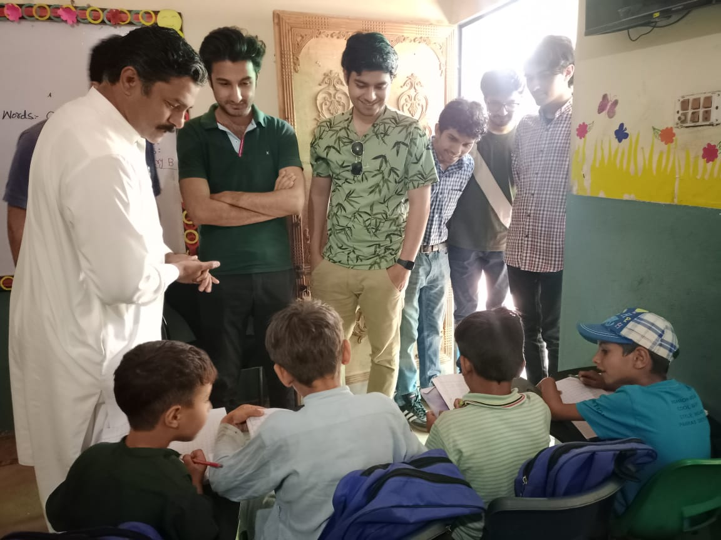
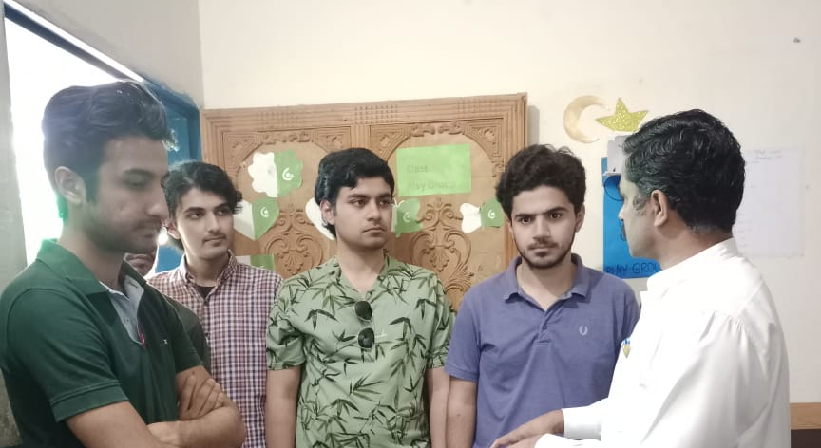
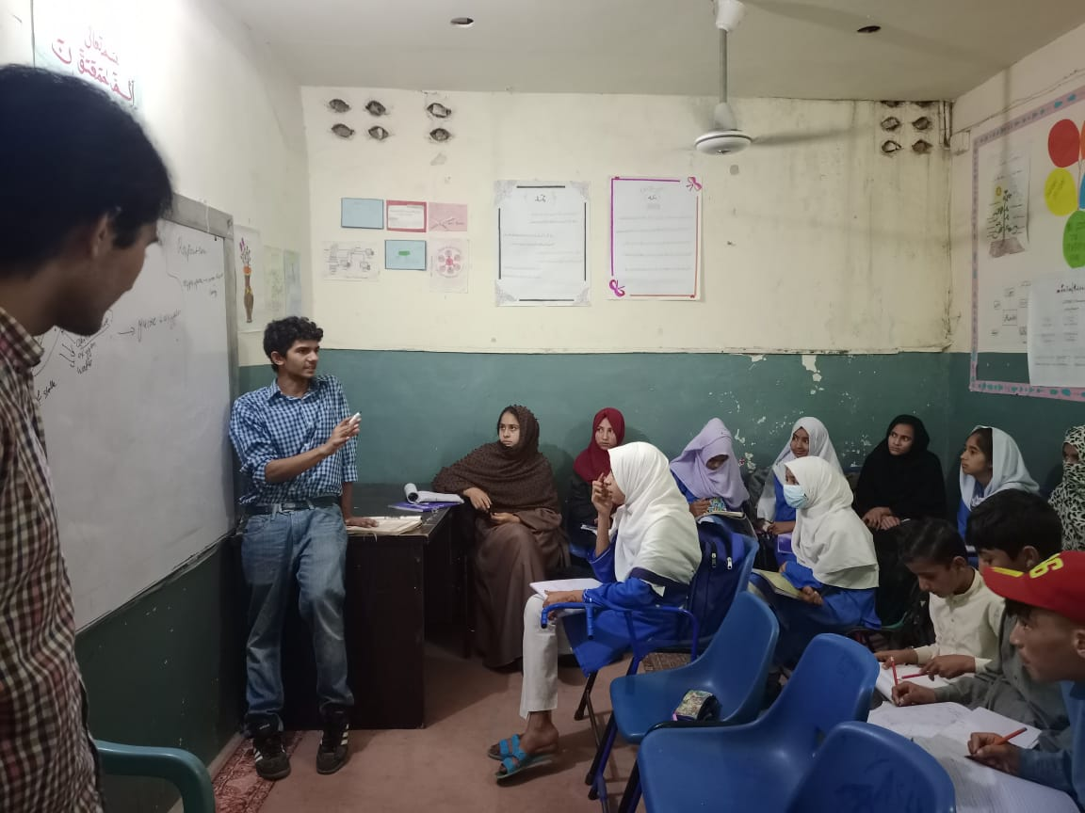

Slide 19
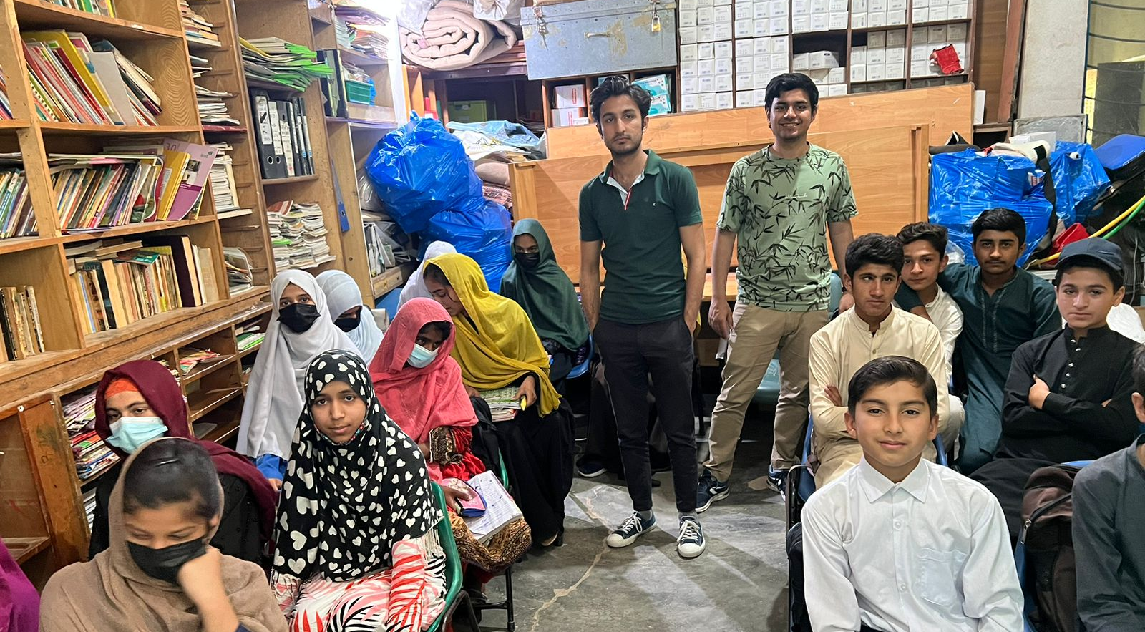

Slide 20
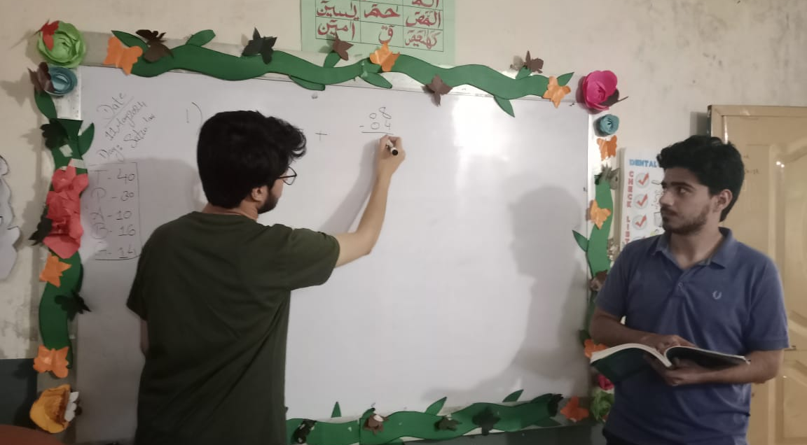

Slide 21
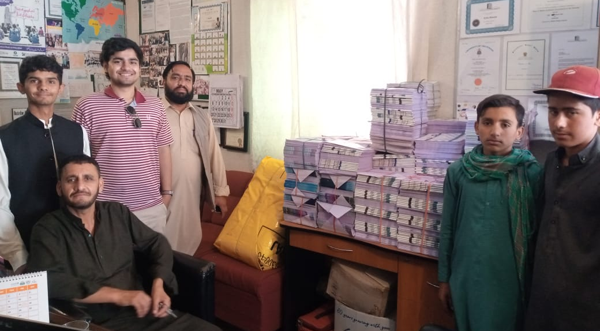

Slide 22
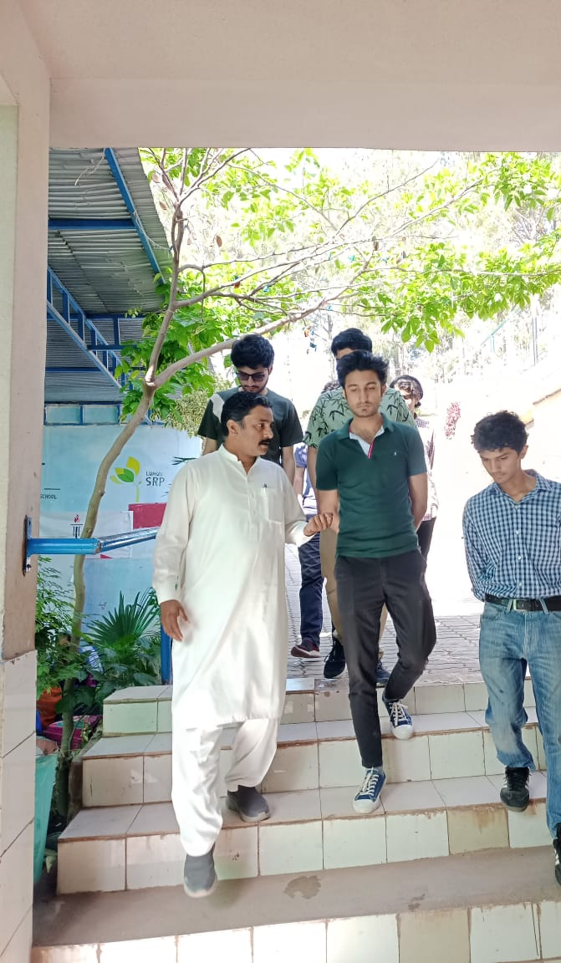
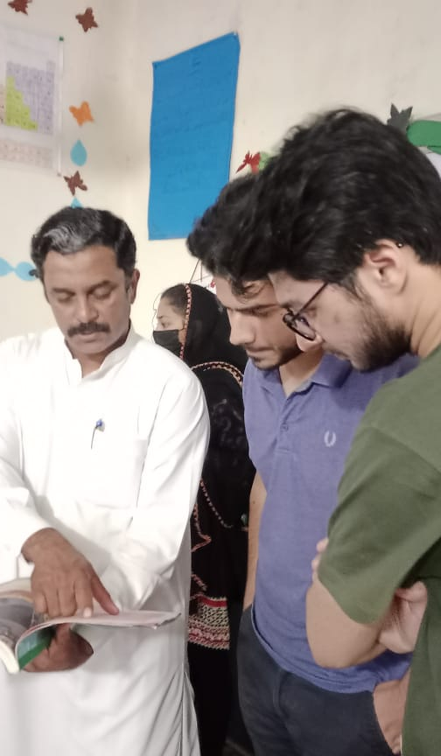

Slide 23
A Paragraph of 150-200 Words

Slide 24
Visit to Mashal Model School
The project was carried out by 6 students of BEE12 to teach young children and pass donation (books and tarpaulin) to the young children studying at Mashal Model School at Muslim Colony led by Zeba Husain.
The old age home is located at Muslim Colony and includes classes from 1 upto 8. The young children were aged between 5 to 3 years. The first stage of the project was to collect funds to donate to the organization followed by acquisition of books, notebooks and tarpaulin.
Donations were collected until May 11, 2024, and the fundraised amount had been PKR 151K. We taught the children two days on May 11 and May 13. The purchased items were delivered to the school on May 14 and May 15.
The items were acquired from Saddique Books, Satco, and Jabib TarpalThe textbooks required were English textbooks for classes 1 and 3.

Slide 25
Thank you!

